Slide 1
SOLID
OOP Principles

Slide 2
What is SOLID?
Single responsibility
Open for extension, closed for modification
Liskov substitution
Interface segregation
Dependency injection
https://www.baeldung.com/solid-principles

Slide 3
Why SOLID?
To create software that is
Maintainable
Understandable
Flexible
Reduce complexity!

Slide 4
Single responsibility

Slide 5
Meaning of single responsibility?
A class should only have one responsibility
Benefits
Testing – A class with one responsibility will have far fewer test cases.
Lower coupling – Less functionality in a single class will have fewer dependencies.
Organization – Smaller, well-organized classes are easier to search than monolithic ones.

Slide 6
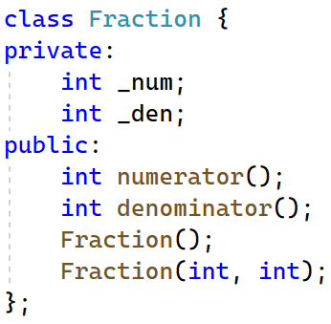
Example
Suppose we have a class Fraction
How do we print out a fraction?
Lowest term: 8/6 => 4/3
Mixed fraction: 8/6 => 1 1/3
Minimal: 4/1 => 4
Decimal: 8/6 => 1.33 / 1.333
Percentage: 8/6 => 133.33%
How do we get a fraction from the keyboard?
Natural input: “8/6”
Enter numerator then enter denominator?

Slide 7
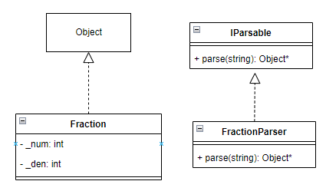
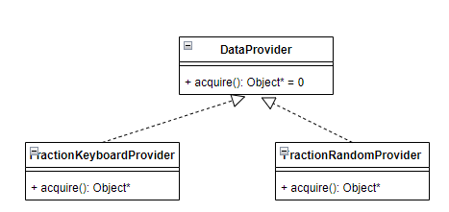
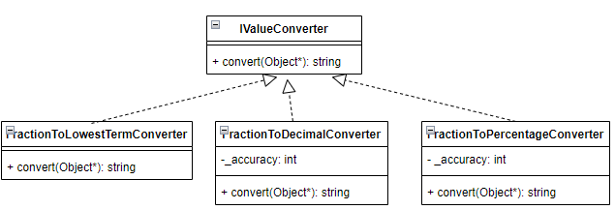
Suggested solution

Slide 8
2. Open /Closed

Slide 9
Open / Close
Classes should be open for extension but closed for modification
We stop ourselves from modifying existing code and causing potential new bugs

Slide 10
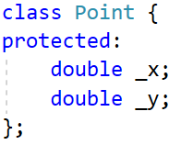
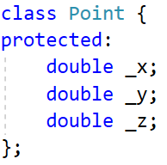
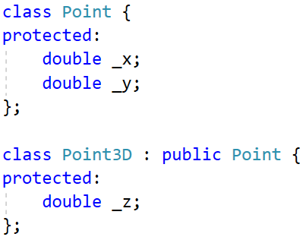
Example
How to support 3 dimensions given the Point (2D) class?

Slide 11
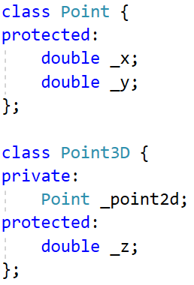
Composition over inheritance
https://en.wikipedia.org/wiki/Composition_over_inheritance
It is better to compose what an object
can do (HAS-A) than extend what it is
Flexibility at runtime
Drawback: forwarding methods

Slide 12
3. Liskov substitution

Slide 13
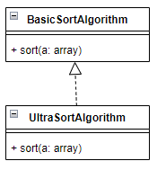
Liskov substitution
Subclasses should be substitutable for their base classes
https://www.baeldung.com/cs/liskov-substitution-principle

Slide 14
4. Interface segregation

Slide 15
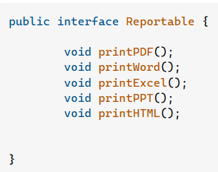
What is interface segregation?
“Clients should not be forced to implement unnecessary methods which they will not use”
What if I only need printPDF & HTML?
java - What is the reasoning behind the Interface Segregation Principle? - Stack Overflow
Split into multiple interfaces?

Slide 16
Multiple abilities
IParsable
IValueConverter
IFormatable
IClonable
ISignature

Slide 17
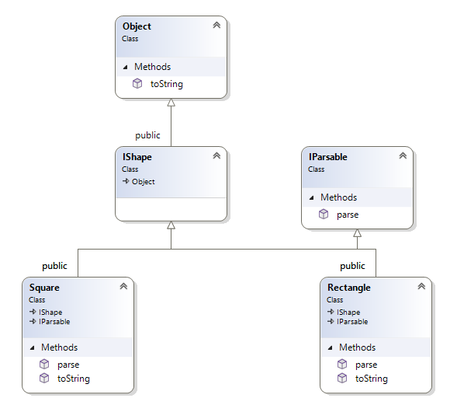
Shape parsers example
Notes:
#include <iostream>
#include <vector>
#include <string>
#include <sstream>
#include <map>
class Object {
public:
virtual std::string toString() = 0;
};
class IParsable {
public:
virtual Object* parse(std::string info) = 0;
};
class IShape: public Object {
};
class Rectangle : public IShape, public IParsable {
public:
std::string toString() override;
Object* parse(std::string info) override;
};
class Square : public IShape, public IParsable {
public:
std::string toString() override;
Object* parse(std::string info) override;
};
// ============================================
std::string Rectangle::toString() {
return "Rectangle";
}
Object* Rectangle::parse(std::string info) {
return new Rectangle();
}
std::string Square::toString() {
return "Square";
}
Object* Square::parse(std::string info) {
return new Square();
}
std::vector<std::string> getData() {
std::vector<std::string> lines = {
"Square Side=10",
"Rectangle Width=20, Height=15",
"Square Side=7"
};
return lines;
}
std::map<std::string, IParsable*> getParsers() {
IShape* parser1 = new Rectangle();
IShape* parser2 = new Square();
std::map<std::string, IParsable*> parsers = {
{parser1->toString(), dynamic_cast<IParsable*>(parser1) },
{parser2->toString(), dynamic_cast<IParsable*>(parser2) },
};
return parsers;
}
int main()
{
auto lines = getData();
auto parsers = getParsers();
std::vector<IShape*> shapes;
for (auto& line : lines) {
std::istringstream reader(line);
std::string type;
getline(reader, type, ' ');
std::string data;
getline(reader, data);
auto parser = parsers[type];
auto shape = dynamic_cast<IShape*>(parser->parse(data));
shapes.push_back(shape);
}
for (auto shape : shapes) {
std::cout << shape->toString() << "\n";
}
}

Slide 18
5. Dependency injection

Slide 19
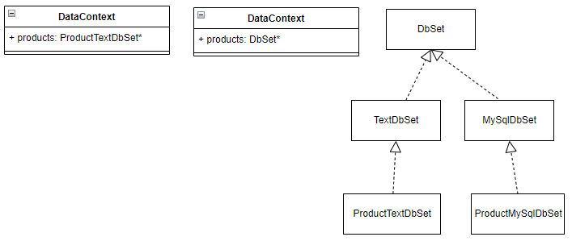
Decoupling of software modules
Instead of high-level modules depending on low-level modules, both will depend on abstractions.

